Slide 1
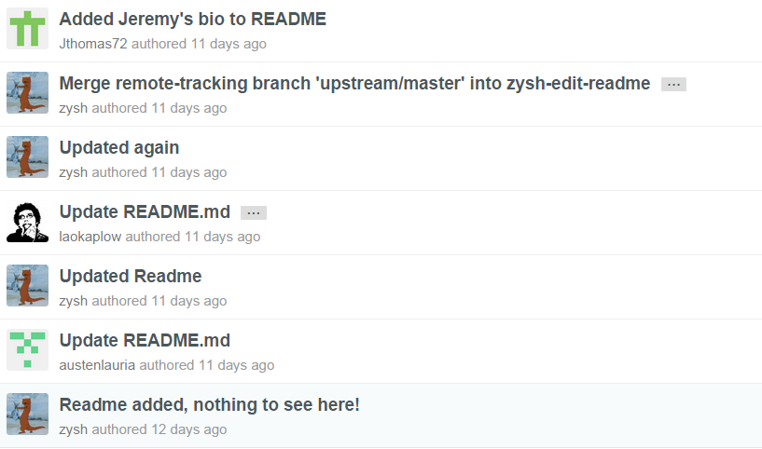

Slide 2
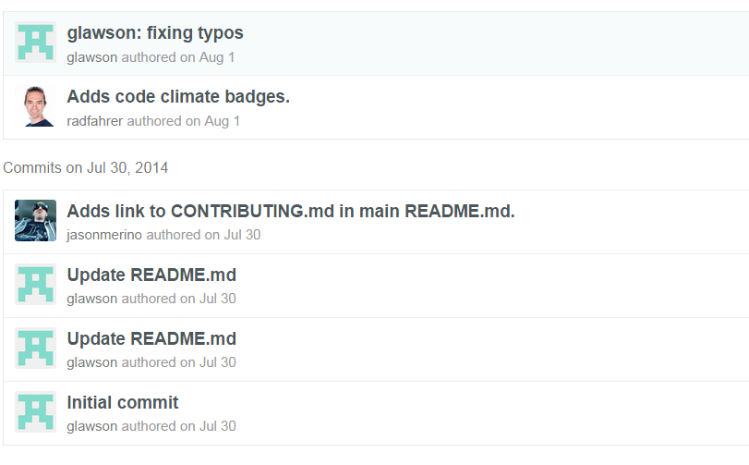

Slide 3
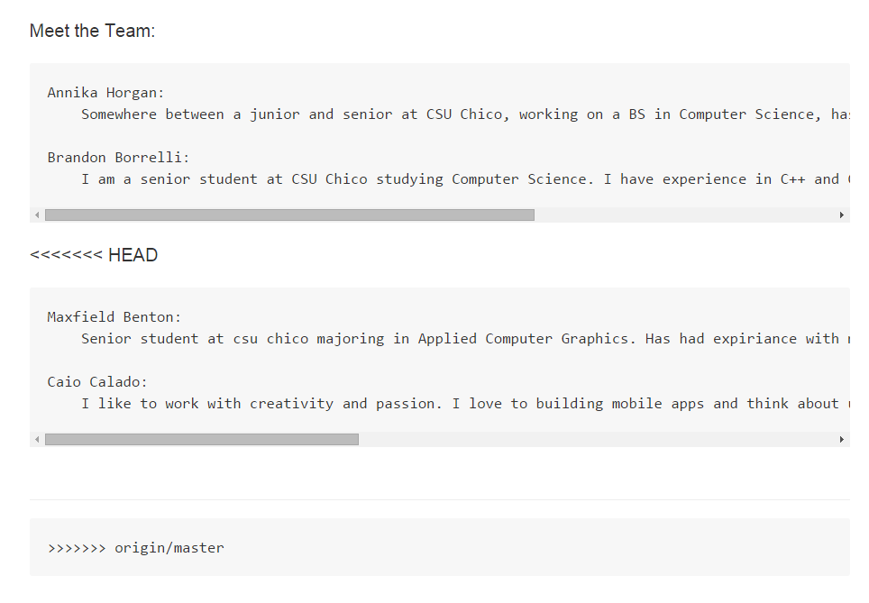

Slide 4
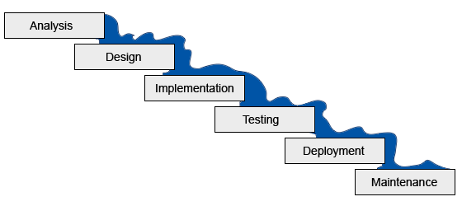

Slide 5
What does Agile mean?
Characteristics
Incremental
Iterative
Adaptive
Collaborative
Interpersonal
Methods
Scrum
Extreme Programming (XP)
…

Slide 6
Roles
Development Team
Self-organized
Collaborative
Cross-functional
Product Owner
Voice of (and to) customer
Product Backlog
Responsible: schedule, priorities, scope, value
Scrum Master
Servant-leader
Remove obstacles
Lead scrums

Slide 7
Activities
Sprint Planning
Iteration of Potentially Shippable Increments
Sprint Backlog
Sprint Review
What was completed?
What is incomplete?
Demo
Sprint Retrospective
Reflect on last sprint
What went well?
What could be improved?
Scrum…

Slide 8
In a breakfast with bacon and eggs, what’s the difference between the Chicken and the Pig?
Notes:
Chicken is involved, but the Pig is committed!

